Slide 1
AI Awareness
By Ruby

Slide 2
About The Workshop
The Focus
Learning how to decipher between ai vs non ai media
How genAI can be used as an ally in your studies
Familiarising ourselves with the SETU AI guidelines
What we will be doing
Situational Kahoot quiz
Identifying the ai images vs non ai image

Slide 3
Why the hard part is necessary

Slide 4
The hard part is where the skill is gained
Knowing the how’s and the why’s means you know enough to be able to apply it to exams or assignments where AI isn’t available to you.
Would you be more comfortable with asking a generative AI model for help instead of asking your lecturer ?

Slide 5
Support vs Cognitive Offloading

Slide 6
Support
Cognitive Offloading
I want to be able to memorise the answers to these questions for my exam. Can you quiz me on each topic until I have grasped each concept. Don’t give me the answers until I have attempted to answer on my own.
This is the brief for my assignment. Can you answer the questions and write a report on your findings. It must be 500 words.

Slide 7
Summarising Prompts
Generative AI uses mass amounts of water and electricity
Can we get our point across in one concise prompt instead of five ?
Avoid using extra words
Get straight to the point
The better the prompt, the better the response

Slide 8


SETU GenAI Student Guidelines
SETU has a set of guidelines that highlight what is and isn’t tolerated with ai and your studies.
The full guidelines can be found at ai.setu.ie/student/resources

Slide 9
SETU GenAI Student Guidelines
Why are the Guidelines in place
To provide clarity on what is acceptable and what is unacceptable.
SETU Position
SETU stresses the importance of your own work.
Also recognises the potential of AI.
Wants to highlight the requirements of declaring AI use.

Slide 10
Before you use AI
Check the ai guidelines.
Check with your lecturer.
Make sure you know how to reference or declare ai use.
Consider what you want to use the ai for. Can you figure it out without ai ?

Slide 11
use
misuse
To draw up plans or flashcards to help you when studying.
Asking to suggest improvements on your work.
To summarise or identify points.
Presenting AI generated work as your own.
Not declaring or referencing AI use.
Relying on AI as a replacement for your own thoughts, opinions or thinking.

Slide 12


Guess the AI Image:

Slide 13
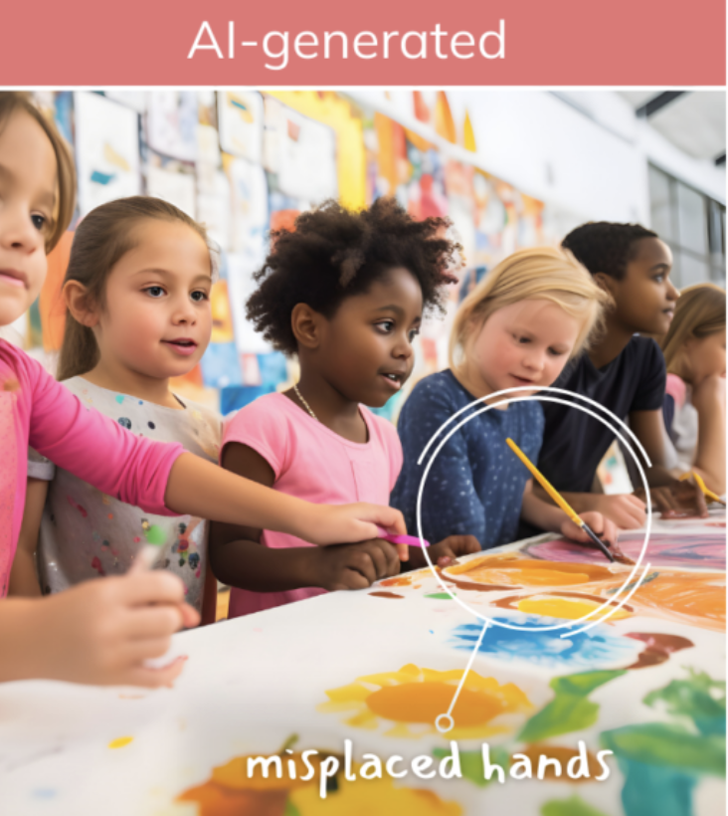
The Generated Image

Slide 14

The Real Image

Slide 15


Example Two

Slide 16
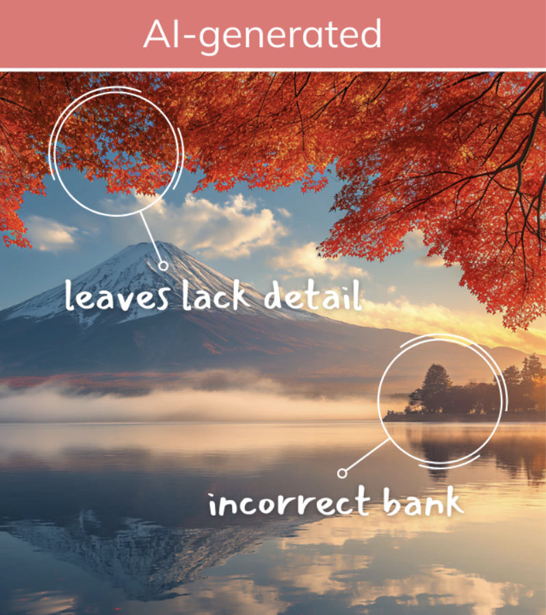
The Generated Image

Slide 17
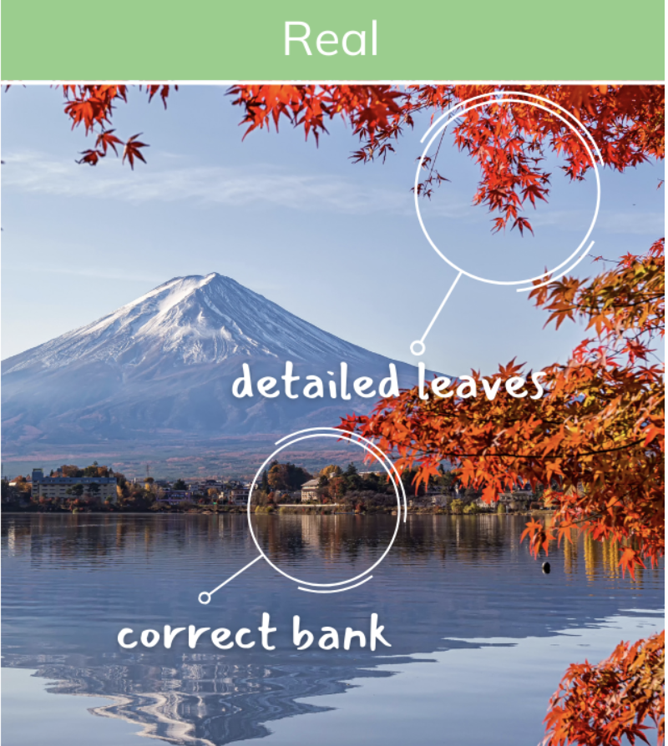
The Real Image

Slide 18


Example Three

Slide 19
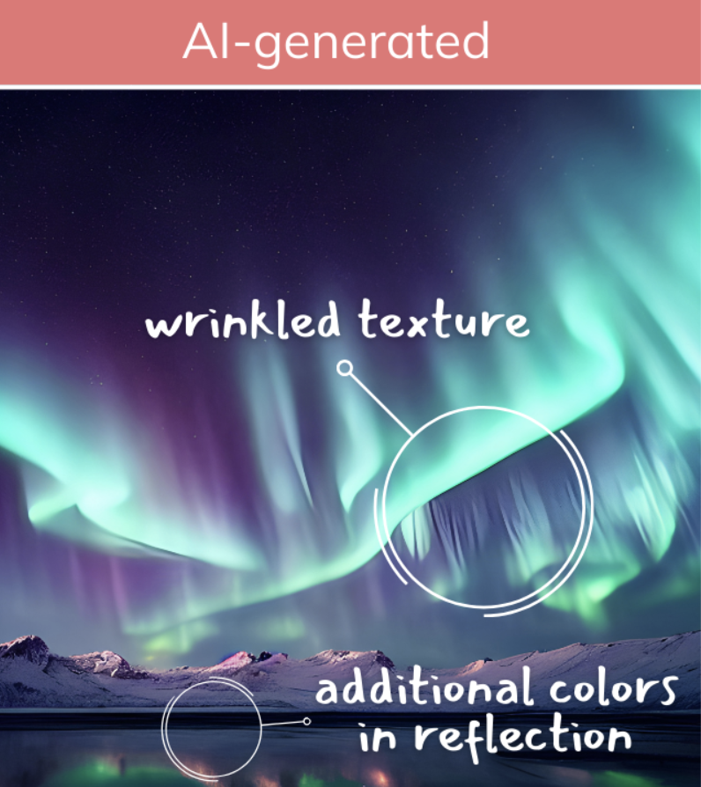
The Generated Image

Slide 20
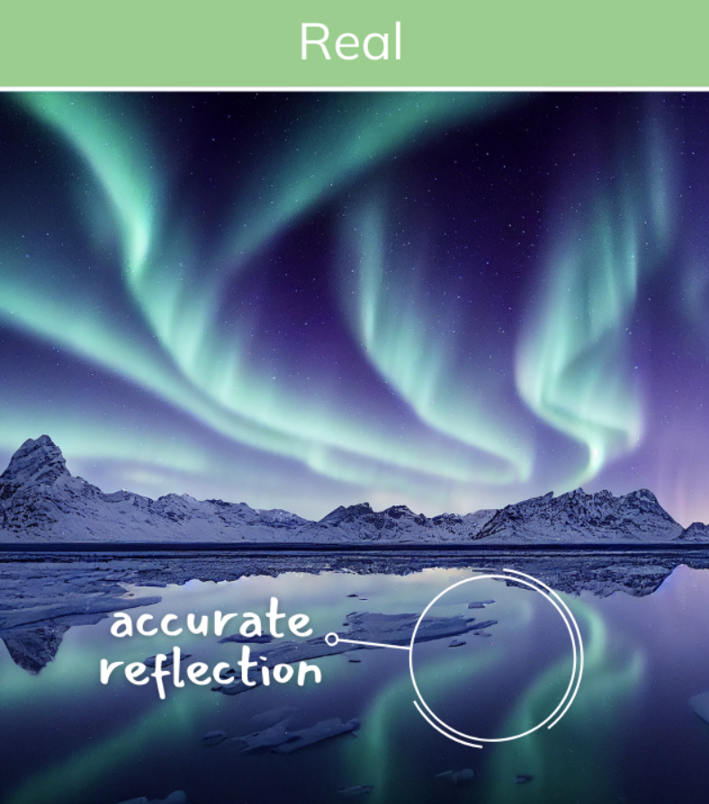
The Real Image

Slide 21
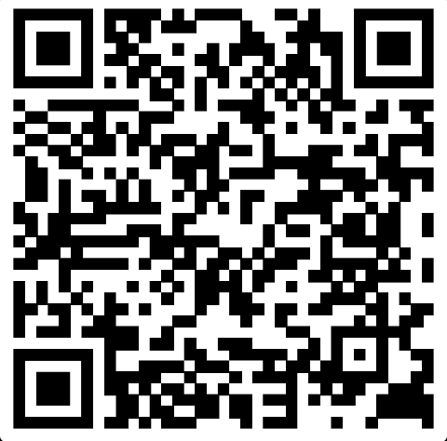
Kahoot Quiz

Slide 22
Any Questions ?

